Slide 1
Special Needs Plan Model of Care Education
2026 Provider Training
Notes:
Thank you for taking time to review the training material on the HealthTeam Advantage Chronic Special Needs Plan Model of Care.

Slide 2
Learning Goals
Background of Medicare Advantage and HealthTeam Advantage (HTA)
What a Chronic Special Needs Plan (C-SNP) is and how it’s different from traditional Medicare Advantage (MA) plans
How beneficiaries qualify for a C-SNP plan
What a Special Needs Plan (SNP) Model of Care (MOC) is
Understanding care coordination for SNP members and the development of an individual care plan (ICP)
Membership and function of the interdisciplinary care team (ICT)
HealthTeam Advantage Diabetes & Heart Care (HMO C-SNP) coverage area
Notes:
The goals of the training are to explain the differences between a Special Needs Plan and standard Medicare Advantage and how Special Needs Plans tailor additional services and benefits to Medicare beneficiaries who are considered more vulnerable. This training will include information of how beneficiaries qualify for a Special Needs Plan, what a Special Needs Plan Model of Care encompasses, and details the critical importance of care coordination for a Special Needs Plan member through the development of an individual care plan and the interdisciplinary care team. HTA serves seven counties with CSNP plan.

Slide 3
Medicare Advantage and HealthTeam Advantage
Medicare Advantage (MA), also known as "Part C", is a type of health plan that provides all the benefits of Original Medicare (Part A and Part B) and often includes prescription drug coverage (Part D).
Conducting business as HealthTeam Advantage, Care N’ Care Insurance Company of North Carolina, Inc., is owned by Cone Health. Cone Health became a part of Risant Health, a nonprofit organization created by Kaiser Foundation Hospitals at the end of 2024.
HealthTeam Advantage incorporated in 2015 and entered the Greensboro Medicare Advantage marketing in 2016 offering plans in 4 North Carolina counties. Since then, the company has grown and now provides coverage for more than 22,000 members throughout 33 North Carolina counties based on plan selected.
HealthTeam Advantage Diabetes & Heart Care (HMO C-SNP) plan is currently available in 7 North Carolina counties: Alamance, Davidson, Davie, Forsyth, Guilford, Randolph, and Rockingham counties.
HealthTeam Advantage offers 5 Medicare Advantage plans. 4 Medicare Advantage Preferred Provider Organization (PPO) plans and one Medicare Advantage Health Maintenance Organization Chronic Special Needs (HMO C-SNP) Plan with membership more than 19,000 in our PPO plans and more than 3,600 HMO C-SNP plan members.
Notes:
HealthTeam Advantage is majority owned by Cone health. It was launched as a new Medicare Advantage insurance plan in 2016, initially serving beneficiaries in Guilford, Alamance, Randolph, and Rockingham counties. Initial enrollment was a little more than 6,000 lives. It has subsequently expanded to 7 counties in North Carolina and provides Medicare Advantage coverage to more than 22,000 beneficiaries (approximately 3,600 CSNP beneficiaries). The HMO CSNP plan was a new offering in 2020 to provide additional coverage options for members with special needs.

Slide 4
What is a Chronic Special Needs Plan?
A Chronic Condition Special Needs Plan (C-SNP) is a type of Medicare Advantage (MA) plan that provides extra support for people with chronic or disabling conditions.
Congress created Special Needs Plans (SNPs) as a new Medicare Advantage (MA) plan type in 2003.
The Center for Medicare & Medicaid Services (CMS) approves three types of SNPs:
Dual-eligible SNPs: enroll only beneficiaries dually entitled to Medicare and Medicaid
Chronic SNPs: enroll only beneficiaries who have certain chronic or disabling conditions
Institutional SNPs: enroll only beneficiaries who reside in institutions or are nursing-home certified
Notes:
When a person qualifies for Medicare, they have several choices. They may remain in the traditional Medicare program, or they can choose a Medicare Advantage plan. In addition to these choices, Medicare beneficiaries with certain qualified conditions or qualifying situations may be able to enroll within a Medicare Advantage Special Needs Plan. CMS has approved three types of Special Needs Plans. The first is designed for beneficiaries who have dual eligibility for both Medicare and Medicaid. The second type is designed for beneficiaries with certain chronic or disabling conditions. Finally, Institutional Special Needs Plans enroll beneficiaries who reside in institutions or are nursing-home certified.

Slide 5
Characteristics of Special Needs Plans
Limited enrollment: Members must have a qualifying condition
Members tend to have multiple comorbid conditions and are more challenging, complicated, and costly to manage
Plan benefits are customized to better meet the needs of the chosen population
Enrollment options are year-round for those with qualifying conditions
There must be a comprehensive SNP Model of Care (MOC) that provides a detailed road map for care management, policies, and clinical operations (The MOC must be approved by NCQA)
Notes:
In general, Special Needs Plans have limited enrollment as potential members must have a qualified condition. Most Special Needs Plan beneficiaries have multiple co-morbid conditions and are more challenging, complicated, and costly to manage. Special Needs Plan benefits are generally customized to better meet the needs of the select population. For each of the Special Needs Plans, a comprehensive Model of Care that provides a detailed roadmap for the care management, policies, and clinical operations must be developed.

Slide 6
CMS List of 22 SNP-specific Chronic Conditions
Medicare Advantage plans target benefits for persons with one or more of the following severe or disabling chronic conditions:
VALUES
Chronic Alcohol Use Disorder and other Substance Use Disorders (SUDs)
Autoimmune Disorders
Cancer
Cardiovascular Disorders
Chronic Heart Failure
Dementia
Diabetes Mellitus
Overweight, Obesity, and Metabolic Syndrome
Chronic Gastrointestinal Disease (CGD)
Chronic Kidney Disease (CKD)
Severe Hematologic Disorders
HIV/AIDS
Chronic Lung Disorders
Chronic and Disabling Mental Health Conditions
Neurologic Disorders
Stroke
Post-organ Transplantation Care
Immunodeficiency and Immunosuppressive Disorders
Conditions associated with cognitive impairment
Conditions with functional challenges that require similar services
Chronic conditions that impair vision, hearing (deafness), taste, touch, and smell
Conditions that require continued therapy services in order for individuals to maintain or retain functioning
Notes:
When Chronic Special Needs Plans were originally developed, a panel was tasked with creating a list of eligible conditions. This ranges from issues with alcohol and drug dependence all the way through neurologic disorders. Most commonly, Chronic Special Needs Plans focus on diabetes mellitus and heart conditions.

Slide 7
HealthTeam Advantage Diabetes & Heart Care (HMO C-SNP)
To join HealthTeam Advantage's Chronic Special Needs Plan (CSNP) Medicare-eligible beneficiaries must meet the special eligibility requirements of a diagnosis of diabetes mellitus, chronic heart failure (CHF), and/or a cardiovascular disorder (CVD).
Eligibility requirements:
Eligible beneficiaries must be entitled to Medicare Part A and enrolled in Part B as of the effective date of coverage
Prospective members must have a verified diagnosis of diabetes mellitus, chronic heart failure (CHF), and/or a cardiovascular disorder (CVD)
Prospective members must live in Alamance, Davidson, Davie, Forsyth, Guilford, Randolph, or Rockingham County
Eligibility will be verified by the following:
Enrollees must attest to having the chronic condition at the point of enrollment. Verification of a member’s diagnosis for enrollment in the CSNP will be confirmed through a provider verification form. Provider verification is required within 30 days of the member's effective date. Failure to return the verification form timely could cause the member's disenrollment from the plan.
Notes:
Given the integration HealthTeam Advantage enjoys with Triad HealthCare Network (THN),a successful ACO and a strong health system, HTA leadership felt the plan was well positioned to offer the expanded comprehensive services needed for a special needs population. Analysis of the existing HTA population indicated a strong need for additional services to manage diabetes and heart failure. Given the increased resources required to manage these more vulnerable members, enrollment was originally limited to a single county (Guilford) but has since been expanded to seven counties. The HTA Diabetes & Heart Care (HMO C-SNP) plan was first offered January 1st, 2020.
Eligibility for a Chronic Special Needs Plans requires first and foremost that potential members be entitled to Medicare benefits. The members will also need to attest that they have Diabetes Mellitus, Chronic Heart Failure, (CHF), and/or a Cardiovascular Disorder (CVD) at the time of their enrollment. Members will only be eligible if they reside in Alamance, Davidson, Davie, Forsyth, Guilford, Randolph or Rockingham counties. A simple chronic condition verification form will need to be completed by their identified PCP to remain enrolled within the CSNP.

Slide 8
HealthTeam Advantage Diabetes & Heart Care (HMO C-SNP)
Our Member Value Proposition
“To partner with beneficiaries in management of their chronic conditions, reduce acute exacerbations of heart failure, improve diabetic control, and generally improve care, outcomes, and the experience of care.”
Disease-specific education
Specially tailored formularies ($0 copayments for key medications)
Care plans directed by local expert physicians
Latest technologic advances to improve monitoring and compliance
$0 copayments for primary care provider visits and certain specialist visits
Individualized member care plan
Care coordination between primary care and specialty services
Healthcare Concierge model for personalized member services
Integrated pharmacist support
Notes:
For potential members with Diabetes Mellitus, Chronic Heart Failure, (CHF), and/or a Cardiovascular Disorder (CVD), a Special Needs Plan provides an opportunity to have insurance coverage designed around their chronic condition. Each member has an assigned care manager who develops an individualized care plan. That care plan is built around national guidelines for the management of diabetes and heart failure but also considers an individual’s unique situation and personal health goals. The benefits are designed to make it easier and more affordable to obtain needed services. There are $0 copays for key specialty visits in addition to the $0 copays for primary care appointments. The medication formulary is tailored specifically to improve affordability and therefore compliance with the medication necessary to improve diabetic control and stabilize heart failure. For the HTA CSNP, the Insulin coverage will be $0 throughout the deductible, initial coverage and coverage gap phases.
These plans are designed to partner with Medicare beneficiaries to better manage their chronic conditions, improve their outcomes as well as their experience of care.

Slide 9
Targeted Care Models Improve Outcomes for Diabetic Members
A study by Avalere Health found diabetic Medicare beneficiaries who are enrolled in C-SNPs experience better outcomes than they would in non-specialized Medicare Advantage plans.
Using a claims-based approach to compare beneficiary outcomes on five clinical and utilization measures, Avalere found that enrollees in a diabetes-focused C-SNP were:
22% more likely to have a primary care visit
10% more likely to receive appropriate diabetes testing
38% less likely to have an inpatient hospital admission
32% less likely to have a readmission
6% more likely to fill (and refill) a prescription for an antidiabetic medication
These findings held true when controlling for expected differences in enrollees’ demographics and health status. The analysis suggests that C-SNPs can improve outcomes for beneficiaries with diabetes compared to non-SNPs.
Notes:
There is evidence that Special Needs Plans can provide beneficiaries with improved outcomes for their chronic conditions. For example, one study by Avalere demonstrated that Medicare beneficiaries with diabetes who were enrolled in a CSNP were significantly more likely to have appropriate testing and improved compliance and less likely to have hospital admissions and/or readmissions compared to similar diabetic members in traditional Medicare Advantage plans.

Slide 10

CMS Model of Care (MOC) Training
Centers for Medicare & Medicaid Services (CMS) Model of Care training is an annual, mandatory requirement for providers, staff, and contractors working with Medicare Advantage Special Needs Plans (SNPs). This training ensures healthcare teams understand how to deliver coordinated, high-quality care tailored to vulnerable Medicare beneficiaries.
Notes:
Special Needs Plans are required to conduct initial and then annual Model of Care training for both in-network and out-of-network providers who see CSNP members on a routine basis. The plan is required to document evidence that the organization makes Model of Care trainings available to these providers and performs outreach when necessary to encourage their completion of this training.

Slide 11
CMS Model of Care (MOC) Training
Special needs plans (SNPs) are required to develop and implement a Model of Care (MOC) for each type of SNP offered.
The MOC provides the structure for care management and coordination for special needs individuals and includes 4 elements.
Model of Care
MOC 1: Description of SNP Population
MOC 2: Care Coordination
MOC 3: Provider Network
MOC 4: Quality Measurements and Performance Improvement
Notes:
What really differentiates a Special Needs Plan from a traditional Medicare Advantage plan is the Model of Care. The Model of Care provides the road map for promoting quality care management as well as the policies and procedures that will be deployed to deliver on the unique needs of enrollees. CMS considers the Model of Care to be a vital quality improvement tool and an integral component for ensuring that the unique needs of each member are identified and addressed. The Model of Care has approximately 75 sections divided into four major elements.

Slide 12
Model of Care Element 1
Special Needs Plan (SNP) Population

Slide 13
Model of Care Element 1
Description of SNP Population
Model of Care
MOC 1: Description of SNP Population
MOC 2: Care Coordination
MOC 3: Provider Network
MOC 4: Quality Measurements and Performance Improvement
Understanding of the intended population with methods to identify the most vulnerable members of this population.
Notes:
The first element of the Model of Care requires that a plan uses analytic, utilization, and cost data to understand the intended population so the most needy and vulnerable members can be identified. The expectation is that the cohort population is evaluated not only for its medical requirements but also social economic needs as well as potential barriers to receiving needed care and services.

Slide 14
Model of Care Element 1
Description of the CSNP Population
HTA’s C-SNP targets Medicare beneficiaries with diabetes, chronic heart failure (CHF), and/or cardiovascular disorders (CVD)
Cardiovascular disorders include cardiac arrhythmias, coronary artery disease, peripheral vascular disease, and chronic venous thromboembolic disorders
Eligible members must be entitled to Medicare Part A and enrolled in Part B and meet Medicare Advantage eligibility requirements
Members must have a verified qualifying diagnosis to enroll
HTA’s C-SNP operates in seven Piedmont Triad North Carolina counties (as CMS-approved)
Population is characterized by complex chronic conditions requiring coordinated, specialized care
Defined eligibility criteria guide the plan’s care coordination, provider network, and quality improvement strategies

Slide 15
Model of Care Element 2
Care Coordination

Slide 16
Model of Care Element 2
Care Coordination
Model of Care
MOC 1: Description of SNP Population
MOC 2: Care Coordination
MOC 3: Provider Network
MOC 4: Quality Measurements and Performance Improvement
Detailed plan for care coordination utilizing the PCP and the member as the center of the care team.
Notes:
The second element of the Model of Care focuses on care coordination. This requires a very detailed description of how the health plan will coordinate the healthcare needs and preferences of the member and share that information with the interdisciplinary care team (IDT). This element includes descriptions of the health risk assessment tool (HRAT), development of the individualized care plan (ICP), and membership of the interdisciplinary care team (IDT).
This element also includes how information will be shared during the care transitions or with other significant changes in the individual care plan.

Slide 17
Model of Care Element 2
Care Coordination (Overview)
Purpose of Care Coordination
Ensure seamless, member-centered care for individuals with severe and disabling chronic conditions
Address medical, behavioral, and social needs
Reduce fragmentation across providers and settings
Interdisciplinary Care Team (ICT)
Member and/or caregiver
Primary Care Provider (PCP)
Specialists relevant to chronic conditions
Care manager
Behavioral health providers
Pharmacist and ancillary providers (as needed)
Care Coordination Model
Centralized care management led by designated care coordinator
Collaboration across all ICT members
Ongoing engagement with the member and caregiver

Slide 18
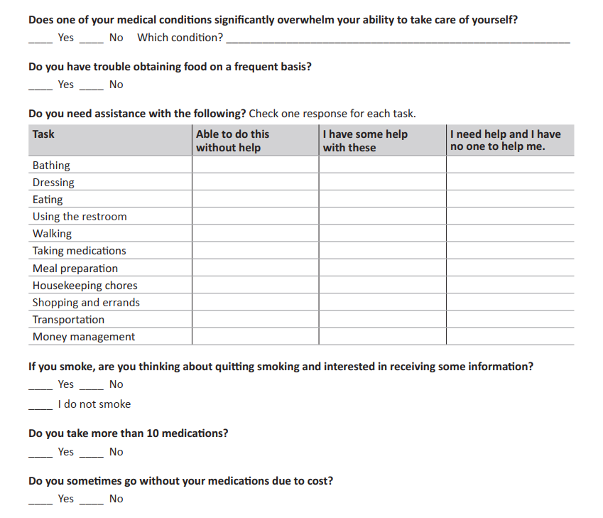
Model of Care Element 2
Health Risk Assessment Tool
Sample Questions
Notes:
HTA member’s special needs assessment and care coordination development begins with a comprehensive health risk assessment tool. It is a CMS requirement that each member enrolled in a Special Needs Plan completes a health risk assessment that addresses not only their medical status but also helps determine social economic needs, barriers to getting care, impediments to activities of daily living, as well as self-reported concerns, and personalized health goals.
This slide shows some sample questions from the HealthTeam Advantage health risk assessment tool. The assessment is available to members online or in print. Assistance is available for members who have difficulty completing the form either through the member’s personal HealthTeam Advantage Healthcare Concierge or their assigned HTA Care Manager.

Slide 19
Model of Care Element 2
Health Risk Assessments (HRAs) and Individual Care Plans (ICPs)
Enrolled Member
Comprehensive Health Risk Assessment
Low Risk
Medium Risk
High Risk (Most Vulnerable)
Utilization and Analytic Data
Notes:
Responses from the health risk assessment, along with any available utilization data, is then used to risk stratify each member into a low-risk, medium-risk, or a high-risk cohort. The high-risk group represents our most vulnerable membership.

Slide 20
Model of Care Element 2
Health Risk Assessment Tool
(HRAT)
Individualized Care Plan
Interdisciplinary Care Team
Notes:
Each unique member of the HTA CSNP will have their own Individual Care Plan (ICP) developed by their assigned Care Manager with input from the interdisciplinary care team as needed. This is created from the HRAT responses along with prior utilization data. Important components will include the member’s own self-stated management goals and health objectives. The ICPs will include disease specific goals based on approved national guidelines. Care plans are reviewed and updated on a regular schedule based on the member’s risk level. Additional reviews and updates are performed as needed during care transitions or based on IDT discussions.

Slide 21
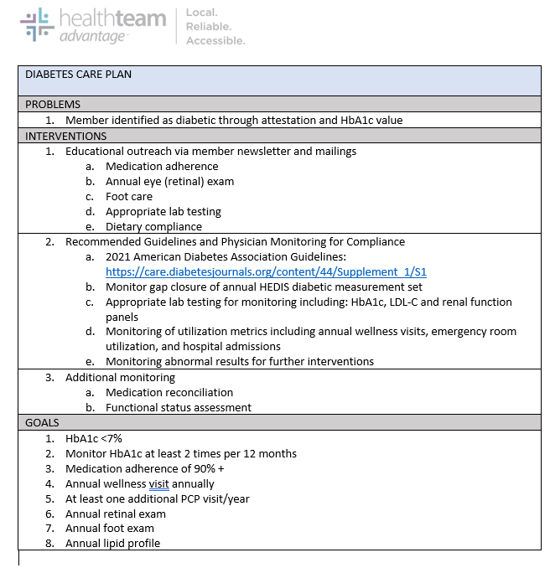
Model of Care Element 2
Individualized Care Plans (ICPs)
High
Risk
Moderate Risk
Low Risk
Notes:
An example diabetes care plan for a low-risk member.

Slide 22
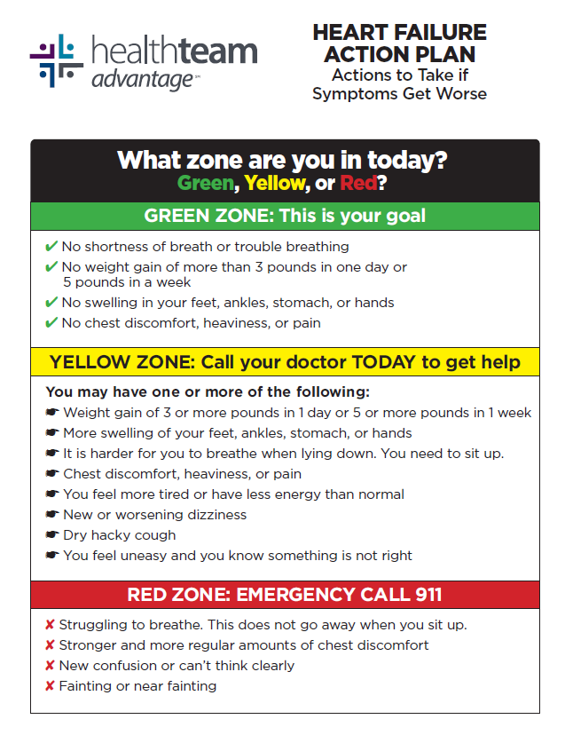
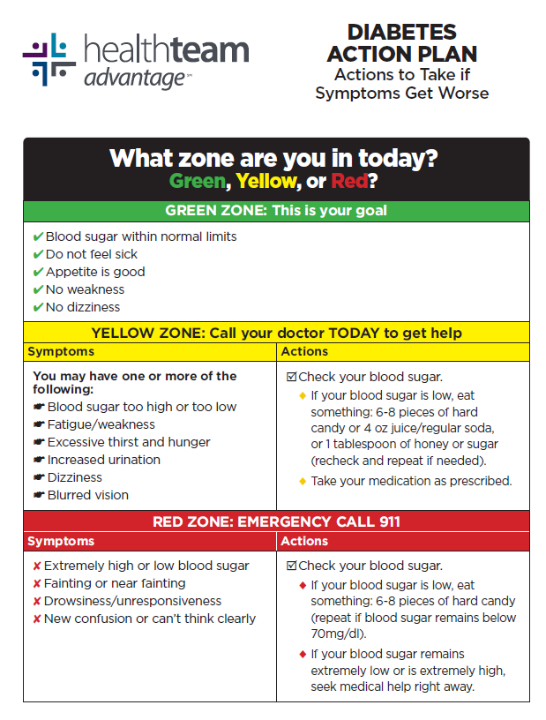
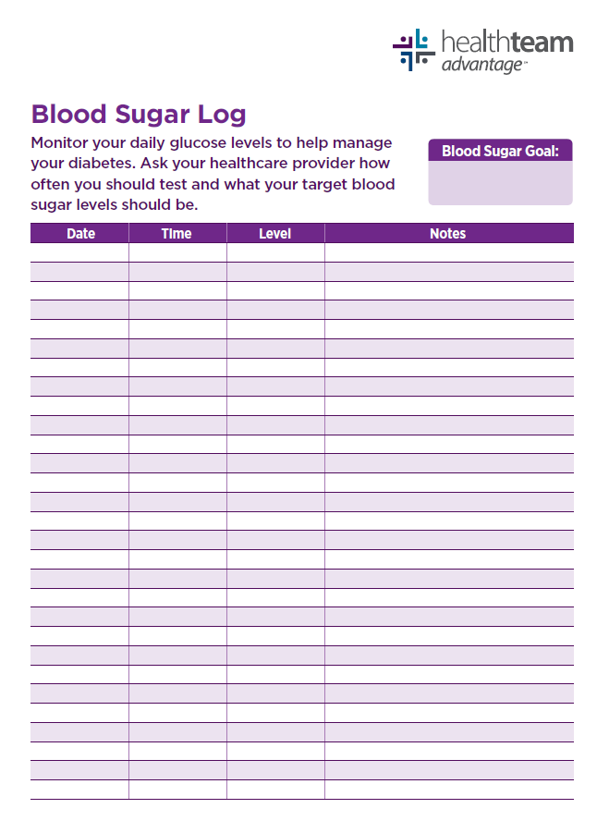
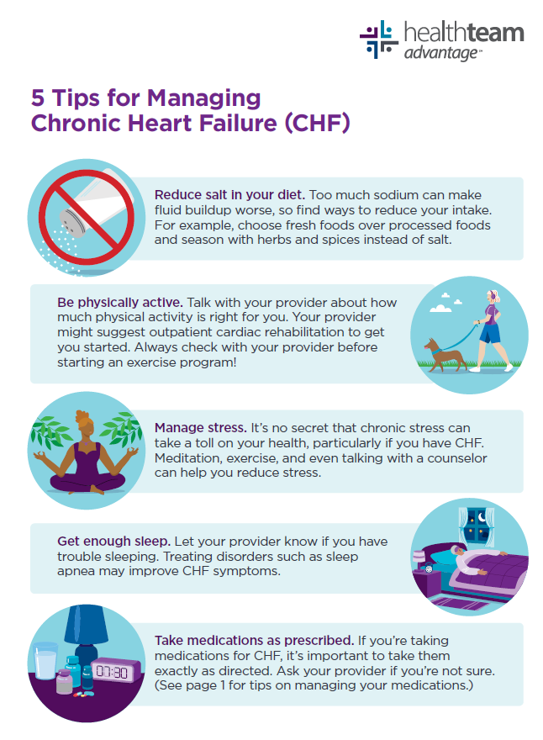
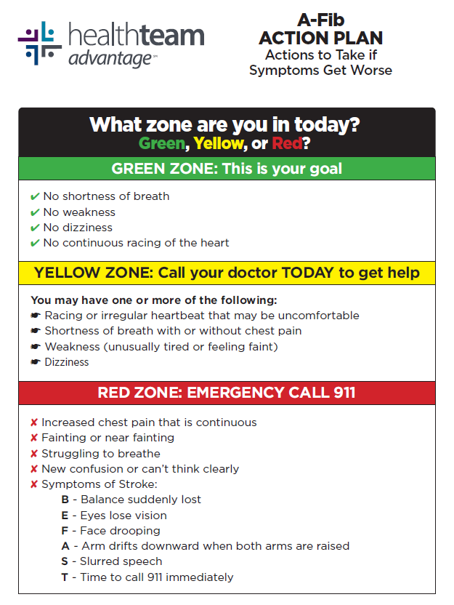
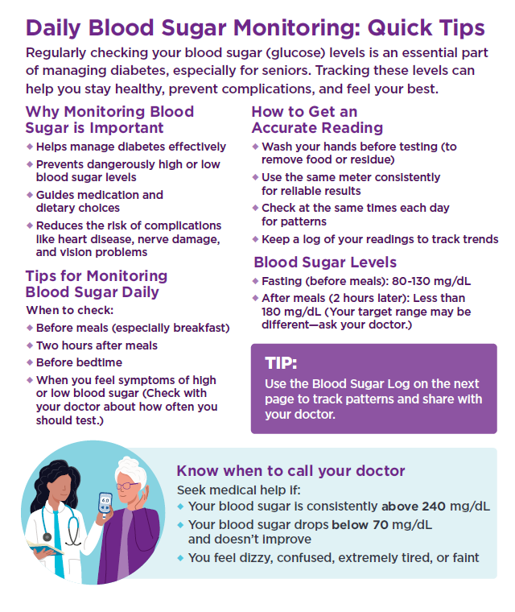
Model of Care Element 2
Member Education and Outreach
Notes:
Member outreach and education efforts are a large component of the ICPs. Member outreach guidelines are based on the member’s risk stratification. Low risk members are outreached at a minimum of annually. Moderate risk members are outreached at least every six months. High risk members are outreached at a minimum of every three months. Additionally, any member who experiences a care transition (i.e., discharge from an acute hospital or skilled nursing facility) will be outreached to ensure their care needs and follow-up care are addressed.
This is an example of some of the education provided by our care team as part of their outreach efforts.
Left: Heart failure zone guide
Right: Personal checklist to track needed care

Slide 23

Model of Care Element 2
Interdisciplinary Care Team
HealthTeam Advantage sends an invitation to the primary care provider along with the care plan.
Notes:
The member and their caregiver(s) are at the center of the Interdisciplinary Care Team (IDT) with their participation being encouraged through self-help strategies and personal health goals established at the time of the HRA. The member’s primary care provider (PCP) is the IDT member who ultimately determines which services the member will receive and should drive clinical decision making. The member’s care manager acts as the coordinator of services and is the single point of contact for all IDT members involved in the member’s care. The other IDT members contribute to care planning and utilization as the members care needs change over time. Additional members may include: specialty physicians, pharmacist, nutritionist, personal health plan concierge, or social worker.

Slide 24
Model of Care Element 3
Provider Network

Slide 25
Model of Care Element 3
Provider Network
Model of Care
MOC 1: Description of SNP Population
MOC 2: Care Coordination
MOC 3: Provider Network
MOC 4: Quality Measurements and Performance Improvement
The SNP provider network is made up of healthcare providers who are contracted to offer healthcare services to SNP members. The PCP is responsible for primary care and care coordination for beneficiaries.
Notes:
The third element of the Model of Care centers is around the provider network. CMS requires that Special Needs Plans demonstrate that the provider network has specialized clinical expertise necessary to deliver the needed care to beneficiaries and processes are in places to oversee that the providers have appropriate credentialing and active licenses.
Provider responsibilities include:
Accepting invitations to participate in member’s IDT meetings whenever possible
Provide feedback to HTA care managers on the ICP
Maintaining copies of the ICP and transition of care notifications in the member’s medical record when received
Collaborating and actively communicating with HTA care managers assigned to the CSNP membership

Slide 26
Model of Care Element 3
Provider Network
Purpose of the Provider Network
Ensure access to specialized, coordinated care for C-SNP members
Support members with severe and disabling chronic conditions
Deliver care that is accessible, culturally competent, and evidence-based
Network Composition
Primary Care Providers (PCPs) with experience in chronic condition management
Specialists relevant to the target conditions (e.g., cardiology, endocrinology)
Behavioral health providers
Ancillary providers (labs, imaging, rehab, DME, home health)
Pharmacists and medication therapy management support

Slide 27
Model of Care Element 3
Network Management & CMS Expectations
Provider Selection & Credentialing
Providers selected based on expertise with target populations
Credentialing and re-credentialing per CMS and state standards
Ongoing evaluation of provider performance and quality outcomes
Care Coordination & Communication
Defined processes for PCP–specialist communication
Use of care plans, referrals, and transitions of care
Shared responsibility for timely information exchange
Access & Availability
Network meets time, distance, and appointment wait-time standards
Access to after-hours care and urgent services
Ensures continuity of care, especially during transitions
Provider Training & Oversight
Training on:
C-SNP Model of Care requirements
Chronic condition management
Cultural competency and health equity
Ongoing monitoring to ensure CMS MOC compliance

Slide 28
Model of Care Element 3
Communication Channels
HealthTeam Advantage
Member
Provider(s)
Provider Portal
Provider Manual
Provider Phone Line
Faxes and Emails
HTA Website
Provider Connections (HTA monthly Provider eNewsletter)
Provider Concierges
Member Connections (HTA monthly member eNewsletter)
Committee Meetings
Notes:
The final sections of the MOC describe how HTA communicates its quality improvement plan and performance to various stakeholders.

Slide 29
Clinical Practice Guidelines
HealthTeam Advantage has adopted the following nationally accepted and locally vetted evidence-based guidelines:
Diabetes:
American Diabetes Association: Standards of Medical Care in Diabetes 2025
Chronic Heart Failure:
2022 ACC/AHA/HFSA Guideline for the Management of Heart Failure
Notes:
HTA has adopted several nationally accepted guidelines for management of members with diabetes and or heart failure. These guidelines have been vetted by local experts as well as the HTA medical management committee. HTA is expected to monitor performance in the use of these guidelines and to have policies and procedures in place to adjust, modify, or alter these guidelines when they are not appropriate for specific vulnerable members
https://www.heart.org/-/media/Files/Professional/Quality-Improvement/Get-With-the-Guidelines/Get-With-The-Guidelines-HF/HF-Awareness-Week-2023/2023New-Heart-Failure-Guidelines-Impact-on-the-Patient-Journey-The-Healthcare-Professional-Perspecti.pdf

Slide 30
Model of Care Element 4
Quality Measurements and Performance Improvement

Slide 31
Model of Care Element 4
Quality Measurements and Performance Improvement
Continuous monitoring of process, performance, and quality outcomes with detailed reporting and improvement strategies.
Model of Care
MOC 1: Description of SNP Population
MOC 2: Care Coordination
MOC 3: Provider Network
MOC 4: Quality Measurements and Performance Improvement
Notes:
HTA employs a comprehensive quality performance and improvement plan. This plan ensures that HTA can monitor and evaluate the effectiveness of the MOC program and make necessary changes to meet and exceed stated goals. This is accomplished in collaboration with its provider network.

Slide 32
Model of Care Element 4
Quality Measurement Overview
Purpose of Quality Measurement
Evaluate effectiveness of the C-SNP Model of Care
Ensure services meet the needs of members with severe and disabling chronic conditions
Drive continuous quality improvement (CQI)
Quality Measurement Framework
Measures aligned with:
CMS Star Ratings
HEDIS
CAHPS
C-SNP-specific clinical outcomes
Use of structure, process, and outcome measures
Key Performance Domains
Clinical quality and health outcomes
C-SNP-specific clinical outcomes
Member experience and satisfaction
Access to care and service utilization
32

Slide 33
Model of Care Element 4
Measurable Goal Examples
Process Measures
HRA completion rate
IDT meeting rates
Percentage of members with ICPs
Complaints about the plan
Percentage of staff and providers that complete annual MOC training
CAHPS survey results around getting needed care and care quickly
Outcome Measures
HEDIS scores for diabetes and hypertension measures
Medication adherence rates
Plan’s all-cause adjusted readmission rate
ED utilization rates
Generic medication dispensing rate
Percentage of members with an assigned PCP
Notes:
These are some of the processes and outcomes HTA measures, appraises, and reports that help gauge the effectiveness of the MOC objectives. These results are shared with leadership as well as representatives of the local medical community through the HTA Medical Management and Quality Committee.

Slide 34
We’re Here for You!
If you have questions or concerns about this training, please contact HealthTeam Advantage.
Ravinder Chawla, MD, MBA
rchawla@htanc.com
Chief Medical Officer
Stephen Evans, MD
sevans@htanc.com
Medical Director
Your Provider Concierge ProviderConcierge@htanc.com
844-806-8217, Option 5
Notes:
In summary, The CMS MOC guidelines require that HTA and its provider network work together for the benefit of our special needs members.
If you have concerns or comments, please reach out to HealthTeam Advantage.

Slide 35
Attestation Thank you for completing our Special Needs Model of Care Training.
CLICK HERE for Provider Attestation Form
To acknowledge your completion of this training, you must complete and submit the attestation form.
H2624_26020_C
Notes:
Thank you for taking care of our members and for participating in this MOC training!
Please complete the attestation.

