Slide 1

HealthTeam Advantage
Chronic Special Needs Plan
Education

Slide 2
Learning Goals
Brief background of Medicare Advantage and HTA
What is a Chronic Special Needs Plan (CSNP) and how does it differ from traditional Medicare Advantage plans?
How do beneficiaries qualify for the plan?
What is a Special Needs Plan (SNP) Model of Care (MOC)?
Understanding the care coordination for SNP members and the development of and individual care plan (ICP)
The membership and function of the interdisciplinary care team (ICT)
Notes:
Thank you for taking time to review the training material on the HealthTeam Advantage Chronic Special Needs Plan Model of Care. The goals of the training are to explain the differences between a Special Needs Plan and standard Medicare Advantage and how Special Needs Plans tailor additional services and benefits to Medicare beneficiaries who are considered more vulnerable. This training will include information of how beneficiaries qualify for a Special Needs Plan, what a Special Needs Plan Model of Care encompasses, and detail the critical importance of care coordination for a Special Needs Plan member through the development of an individual care plan and the interdisciplinary care team.

Slide 3
Medicare Advantage and HealthTeam Advantage
HealthTeam Advantage launched as new Medicare Advantage plan in 2016
  Guilford, Alamance, Randolph, and Rockingham
  Now in 7 NC Counties (Alamance, Davidson, Davie, Guilford, Forsyth, Randolph, Rockingham)
Cone Health owns 100% of HTA
Two PPO products with 6,200 initial lives
Current membership is around 15,000
The HTA vision is to be the insurer of choice! And, thoughtfully explore geographic expansion, other product lines and continued evaluation of other opportunities.
Notes:
HealthTeam Advantage is 100% owned by Cone health. It was launched as a new Medicare Advantage insurance plan in 2016, initially serving beneficiaries in Guilford, Alamance, Randolph, and Rockingham counties. Initial enrollment was a little more than 6,000 lives. It has subsequently expanded to 7 counties in North Carolina and provides Medicare Advantage coverage to more than 15,000 beneficiaries. The HMO CSNP plan is a new offering in 2020 to provide additional coverage options for members with special needs.

Slide 4
Medicare Advantage and Medicare Special Needs Plans
Congress created Special Needs Plans (SNPs) as a new Medicare Advantage (MA) plan type in 2003
The Center for Medicare & Medicaid Services (CMS) approves three types of SNPs:
  Dual-eligible SNPs: enroll only beneficiaries dually entitled to Medicare and Medicaid
  Chronic SNPs: enroll only beneficiaries who have certain chronic or disabling conditions
  Institutional SNPs: enroll only beneficiaries who reside in institutions or are nursing-home certified
Notes:
When a person qualifies for Medicare, they have several choices. They may remain in the traditional Medicare program or they can choose a Medicare Advantage plan. In addition to these choices, Medicare beneficiaries with certain qualified conditions or qualifying situations may be able to enroll within a Medicare Advantage Special Needs Plan. CMS has approved three types of Special Needs Plans. The first is designed for beneficiaries who have dual eligibility for both Medicare and Medicaid. The second type is designed for beneficiaries with certain chronic or disabling conditions. Finally, institutional Special Needs Plans enroll beneficiaries who reside in institutions or are nursing home certified.

Slide 5
Characteristics of Special Needs Plans
Limited enrollment: Members must have a qualifying condition
The members tend to have multiple comorbid conditions and are more challenging, complicated, and costly to manage
Plan benefits are customized to better meet the needs of the chosen population
Enrollment options are year-round for those with qualifying conditions
There must be a comprehensive SNP Model of Care (MOC) that provides a detailed road map for care management, policies, and clinical operations (The MOC must be approved by NCQA)
Notes:
In general, Special Needs Plans have limited enrollment as potential members must have a qualified condition. Most Special Needs Plan beneficiaries have multiple comorbid conditions and are more challenging, complicated, and costly to manage. Special Needs Plan benefits are generally customized to better meet the needs of the select population. For each of the Special Needs Plans, a comprehensive Model of Care that provides a detailed roadmap for the care management, policies, and clinical operations must be developed.

Slide 6
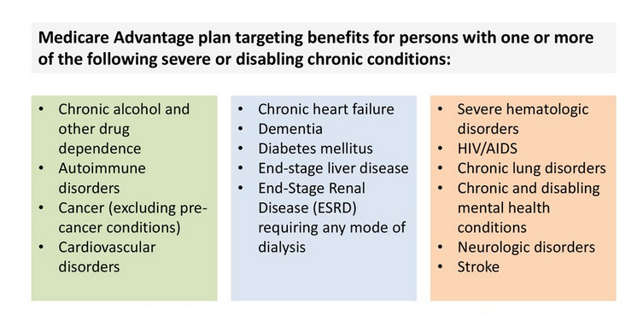
The CMS List of 15 SNP-specific Chronic Conditions
Notes:
When Chronic Special Needs Plans were originally developed, a panel was tasked with creating a list of eligible conditions. This ranges from issues with alcohol and drug dependence all the way through neurologic disorders. Most commonly, Chronic Special Needs Plans focus on diabetes mellitus and heart conditions.

Slide 7
HTA’s Diabetes & Heart Care HMO CSNP
HealthTeam Advantage has expanded its existing Medicare Advantage product line by offering a Chronic Special Needs Plan (CSNP) for Medicare eligible beneficiaries who have diabetes and/or chronic heart failure.
Eligibility requirements:
Eligible beneficiaries must be entitled to Medicare Part A and enrolled in Part B as of the effective date of coverage
Prospective members must have a verified diagnosis of diabetes and/or congestive heart failure
Prospective members must reside in Guilford County
Prospective members must not have a diagnosis of End Stage Renal Disease (this restriction will be waived if the prospective member is a current member of an HTA PPO plan)
Eligibility will be verified by the following:
At the point of enrollment, enrollees must attest to having the chronic condition. Verification of a member’s diagnoses for enrollment in the CSNP will be confirmed through a provider verification form.
Notes:
Given the integration HealthTeam Advantage enjoys with a successful ACO (THN) and a strong health system, HTA leadership felt the plan was well positioned to offer the expanded comprehensive services needed for a special needs population. Analysis of the existing HTA population indicated a strong need for additional services to manage diabetes and heart failure. Given the increased resources required to manage these more venerable members, enrollment was limited to a single county (Guilford) with plans to expand as we gain experience. The HTA Diabetes & Heart Care HMO CSNP was first offered January 1st, 2020.
Eligibility for a Chronic Special Needs Plans requires first and foremost that potential members be entitled to Medicare benefits. The members will also need to attest that they have diabetes, congestive heart failure, or both conditions at the time of their enrollment. Members will only be eligible if they reside in Guilford County. A simple chronic condition verification form will need to be completed by their identified PCP to remain enrolled within the CSNP.

Slide 8
Customer Value Proposition
“To partner with beneficiaries in management of their chronic conditions, reduce acute exacerbations of heart failure, improve diabetic control and generally improve care, outcomes and the experience of care.”
Individualized member care plan
Care coordination between primary care and specialty services
Concierge model for personalized customer service
Integrated pharmacist support
Disease specific education
Specially tailored formularies ($0 copays for key meds)
Care plans directed by local expert physicians
Latest technologic advances to improve monitoring and compliance
Notes:
For potential members with diabetes and/or heart failure, a Special Needs Plan provides an opportunity to have insurance coverage designed around their chronic condition. Each member has an assigned care manager who develops an individualized care plan. That care plan is built around national guidelines for the management of diabetes and heart failure but also considers an individual’s unique situation and personal health goals. The benefits are designed to make it easier and more affordable to obtain needed services. There are $0 copays for key specialty visits in addition to the $0 copays for primary care appointments. The medication formulary is tailored specifically to improve affordability and therefore compliance with the medication necessary to improve diabetic control and stabilize heart failure. These plans are designed to partner with Medicare beneficiaries to better manage their chronic conditions, improve their outcomes as well as their experience of care.

Slide 9
Effect of CSNP Enrollment on Outcomes for Medicare Beneficiaries with Diabetes
Diabetic Medicare beneficiaries who are enrolled in CSNPs experience better outcomes than they would in non-specialized Medicare Advantage plans. Using a claims-based approach to compare beneficiary outcomes on five clinical and utilization measures, Avalere found that enrollees in a diabetes-focused CSNP were:
• 22% more likely to have a primary care visit
• 10% more likely to receive appropriate diabetes testing
• 38% less likely to have an inpatient hospital admission
• 32% less likely to have a readmission
• 6% more likely to fill (and refill) a prescription for an antidiabetic medication
These findings held true when controlling for expected differences in enrollees’ demographics and health status. The analysis suggests that CSNPs can improve outcomes for beneficiaries with diabetes compared to non-SNPs.
Notes:
There is evidence that Special Needs Plans can provide beneficiaries with improved outcomes for their chronic conditions. For example, one study by Avalere demonstrated that Medicare beneficiaries with diabetes who were enrolled in a CSNP were significantly more likely to have appropriate testing and improved compliance and less likely to have hospital admissions and/or readmissions compared to similar diabetic members in traditional Medicare Advantage plans.

Slide 10


CMS Model of Care (MOC) Training Requirements
HealthTeam Advantage is required to conduct initial and annual training for in-network and out-of-network providers seen by members on a routine basis
Notes:
Special Needs Plans are required to conduct initial and then annual Model of Care training for both in-network and out-of-network providers who see CSNP members on a routine basis. The plan is required to document evidence that the organization makes Model of Care trainings available to these providers and performs outreach when necessary to encourage their completion of this training.

Slide 11
Every SNP must have a Model of Care (MOC)
Model of Care
MOC 1: Description of SNP Population
MOC 2: Care Coordination
MOC 3: Provider Network
MOC 4: MOC Quality Measurements and Performance Improvement
The MOC is developed to assure that beneficiaries’ unique needs are identified and addressed. CMS mandates that staff and providers involved with this population undergo annual training on the MOC.
Notes:
What really differentiates a Special Needs Plan from a traditional Medicare Advantage plan is the Model of Care. The Model of Care provides the road map for promoting quality, care management as well as the policies and procedures that will be deployed to deliver on the unique needs of enrollees. CMS considers the Model of Care to be a vital quality improvement tool and an integral component for ensuring that the unique needs of each member are identified and addressed. The Model of Care has approximately 75 sections divided into four major elements.

Slide 12
MOC Element #1
Model of Care
MOC 1: Description of SNP Population
MOC 2: Care Coordination
MOC 3: Provider Network
MOC 4: MOC Quality Measurements and Performance Improvement
Understanding of the intended population with methods to identify the most vulnerable members of this population.
Notes:
The first element of the Model of Care requires that a plan uses analytic, utilization, and cost data to understand the intended population so the most needy and vulnerable members can be identified. The expectation is that the cohort population is evaluated not only for its medical requirements but also social economic needs as well as potential barriers to receiving needed care and services. We analyzed our current Guilford county membership who have diabetes and/or heart failure to access not only their medical status but utilization patterns, social factors, cognitive challenges, and medical comorbidities to understand the most vulnerable sub-groups that require the most comprehensive care management and ancillary services.

Slide 13
MOC Element #2
Model of Care
MOC 1: Description of SNP Population
MOC 2: Care Coordination
MOC 3: Provider Network
MOC 4: MOC Quality Measurements and Performance Improvement
Detailed plan for care coordination utilizing the PCP and the member as the center of the care team
Notes:
The second element of the Model of Care focuses on care coordination. This requires a very detailed description of how the health plan will coordinate the healthcare needs and preferences of the member and share that information with the interdisciplinary care team (IDT). This element includes descriptions of the health risk assessment tool (HRAT), development of the individualized care plan (ICP), and membership of the interdisciplinary care team (ICT).
This element also includes how information will be shared during the care transitions or with other significant changes in the individual care plan.

Slide 14
Health Risk Assessment Tool
(HRAT)
Individualized Care Plan
Interdisciplinary Care Team
Notes:
HTA member’s special needs assessment and care coordination development begins with a comprehensive health risk assessment tool. It is a CMS requirement that each member enrolled in a Special Needs Plan completes a health risk assessment that addresses not only their medical status but also helps determine social economic needs, barriers to getting care, impediments to activities of daily living, as well as self-reported concerns and personalized health goals.

Slide 15
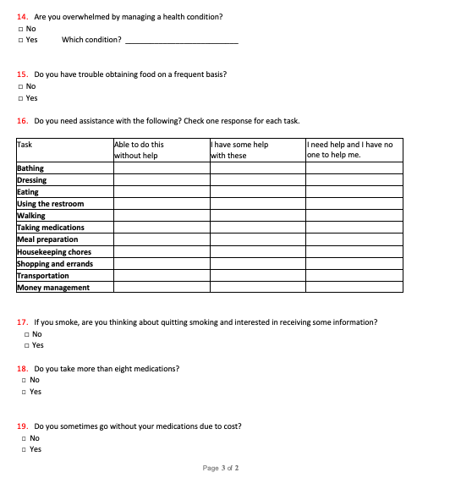
Health Risk Assessment Tool
Sample Questions
Notes:
This slide shows some sample questions from the HealthTeam Advantage health risk assessment tool. The assessment is available to members online or in print. Assistance is available for members who have difficulty completing the form either through the member’s personal HealthTeam Advantage Healthcare Concierge or their assigned THN Care Manager.

Slide 16
Health Risk Assessments (HRAs) and Individual Care Plans (ICPs)
Enrolled Member
Comprehensive Health Risk Assessment
Low Risk
Medium Risk
High Risk (Most Vulnerable)
Utilization and Analytic Data
Notes:
Responses from the health risk assessment, along with any available utilization data, is then used to risk stratify each member into a low-risk, medium-risk or a high-risk cohort. The high-risk group represents our most vulnerable membership.

Slide 17
Health Risk Assessment Tool
(HRAT)
Individualized Care Plan
Interdisciplinary Care Team
Notes:
Each unique member of the HTA CSNP will have their own Individual Care Plan (ICP) developed by their assigned Care Manager with input from the interdisciplinary care team as needed. This is created from the HRAT responses along with prior utilization data. Important components will include the member’s own self-stated management goals and health objectives. The ICPs will include disease specific goals based on approved national guidelines. Care plans are reviewed and updated on a regular schedule based on the member’s risk level. Additional reviews and updates are performed as needed during care transitions or based on IDT discussions.

Slide 18
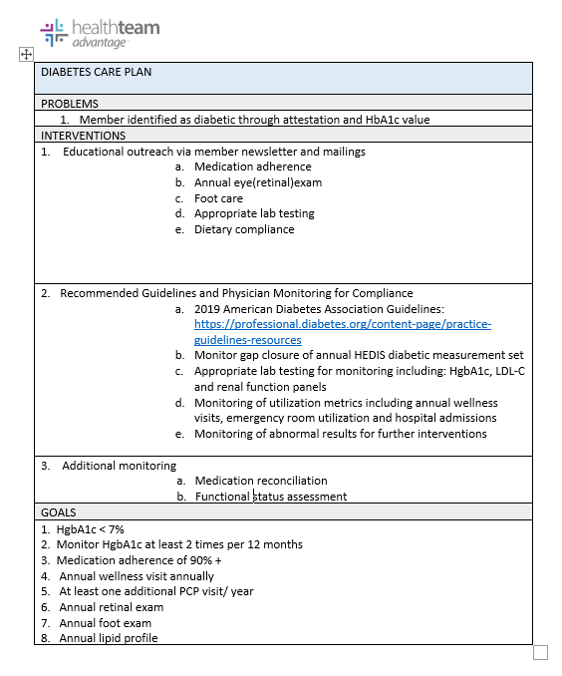
Individualized Care Plans (ICPs)
High
Risk
Moderate Risk
Low Risk
Notes:
An example diabetes care plan for a low-risk member.

Slide 19
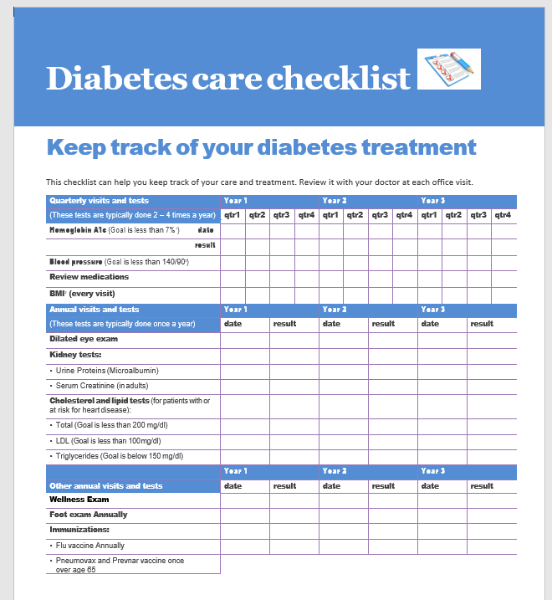
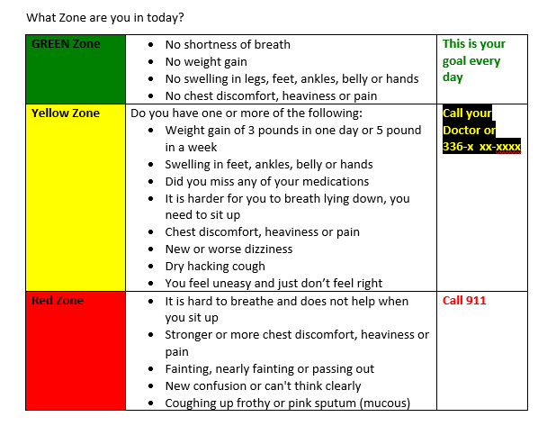
Member Education and Outreach
Notes:
Member outreach and education efforts are a large component of the ICPs. These are some examples:
Left: Heart failure zone guide
Right: Personal checklist to track needed care

Slide 20
The Interdisciplinary Care Team (IDT)
Member
Primary Care Provider
Case Manager
Plan Medical Directors
Personal concierge
Family and home support
Nutritionist
Cardiologist and Endocrinologist
Notes:
The member and their caregiver(s) are at the center of the Interdisciplinary Care Team (IDT) with their participation being encouraged through self-help strategies and personal health goals established at the time of the HRA. The member’s primary care physician (PCP) is the IDT member who ultimately determines which services the member will receive and should drive clinical decision making. The member’s care manager acts as the coordinator of services and is the single point of contact for all IDT members involved in the member’s care. The other IDT members contribute to care planning and utilization as the members care needs change over time. Additional members may include: specialty physicians, pharmacist, nutritionist, personal health plan concierge, or social worker.

Slide 21
MOC Element #3
Model of Care
MOC 1: Description of SNP Population
MOC 2: Care Coordination
MOC 3: Provider Network
MOC 4: MOC Quality Measurements and Performance Improvement
A strong and comprehensive network of facilities and providers able to execute the care plans for members using appropriate guidelines
Notes:
The third element of the Model of Care centers around the provider network. CMS requires that Special Needs Plans demonstrate that the provider network has specialized clinical expertise necessary to deliver the needed care to beneficiaries and processes are in places to oversee that the providers have appropriate credentialing and active licenses.
Provider responsibilities include:
Accepting invitations to participate in member’s IDT meetings whenever possible
Provide feedback to THN care managers on the ICP
Maintaining copies of the ICP and transition of care notifications in the member’s medical record when received
Collaborating and actively communicating with THN care managers assigned to the CSNP membership

Slide 22
HTA Clinical Practice Guidelines
HealthTeam Advantage has adopted the following nationally accepted and locally vetted evidence-based guidelines:
  Diabetes:
    American Diabetes Association: Standards of Medical Care in Diabetes-2019
    https://care.diabetesjournals.org/content/42/Supplement_1/S1
    https://clinical.diabetesjournals.org/content/37/1/11 (abridged version for Primary Care)
  Congestive Heart Failure:
    2017 ACC/AHA/HFSA Focused Update Guideline for the Management of Heart Failure https://www.acc.org/latest-in-cardiology/ten-points-to-remember/2017/04/27/15/50/2017-acc-aha-hfsa-focused-update-of-hf-guideline
Notes:
HTA has adapted several nationally accepted guidelines for management of members with diabetes and or heart failure. These guidelines have been vetted by local experts as well as the HTA medical management committee. HTA is expected to monitor performance in the use of these guidelines and to have policies and procedures in place to adjust, modify, or alter these guidelines when they are not appropriate for specific vulnerable members

Slide 23
MOC Element #4
Model of Care
MOC 1: Description of SNP Population
MOC 2: Care Coordination
MOC 3: Provider Network
MOC 4: MOC Quality Measurements and Performance Improvement
Continuous monitoring of process, performance and quality outcomes with detailed reporting and improvement strategies
Notes:
HTA employs a comprehensive quality performance and improvement plan. This plan ensures that HTA can monitor and evaluate the effectiveness of the MOC program and make necessary changes to meet and exceed stated goals. This is accomplished in collaboration with its provider network.

Slide 24
Measurable Goal Examples
Process Measures
HRA completion rate
ICT meeting rates
Percentage of members with ICPs
Complaints about the plan
Percentage of staff that completes annual MOC training
CAHPs survey results around getting needed care and care quickly
Outcome measures
HEDIS scores for diabetes and hypertension measures
Medication adherence rates
Plan’s all-cause readmission rate
ED utilization rates
Generic medication dispensing rate
Percentage of members with an assigned PCP
Notes:
These are some of the processes and outcomes HTA measures, appraises, and reports that help gauge the effectiveness of the MOC objectives. These results are shared with leadership as well as representatives of the local medical community through the HTA Medical Management and Quality Committee.

Slide 25
Communication Plan
HealthTeam Advantage
Member
Provider(s)
Provider Portal
Provider Manual
Provider Phone Line
Faxes and Emails
HTA and THN Websites
THN Beacon
THN Performance Specialists
Plan and THN Websites
Member Newsletters
Provider Division Meetings and Town Halls
Committee Meetings
Notes:
The final sections of the MOC describe how HTA communicates its quality improvement plan and performance to various stakeholders.

Slide 26

If you have questions or concerns
please reach out!
David Grapey, MD, MHA, FACS
Chief Medical Officer
HealthTeam Advantage
Cell: 336.706.0030
Email: dgrapey@healthteamadvantage.com
Notes:
In summary, The CMS MOC and MOC guidelines require that HTA and its provider network work together for the benefit of our special needs members. This is done through:
Enhanced communication with members, HTA, and the providers
Interdisciplinary approach to meeting medical as well as social needs
Comprehensive coordinated care across the entire care journey
Consideration for an individual member’s care plan preferences and self-care goals
Strategic quality improvement plan with monitoring and adjustments as needed to maximize effectiveness
If you have concerns or comments, please reach out to HealthTeam Advantage

Slide 27

Thank you!
You have completed the Model of Care Training
Please complete the attestation.
Open Form
https://healthteamadvantage.com/required-annual-model-of-care-training-for-csnp-providers/attestation/
Notes:
Thank you for taking care of our members and for participating in this MOC training!
Please complete the attestation

